Slide 1

Beyond Compliance: Staying Out in Front of Digital Accessibility Legal Trends Lainey Feingold Sue Boyd

Slide 2

Potential Sources of Legal Obligation
United States
Americans with Disabilities Act
Rehabilitation Act Sections 504 & 508
State and local laws
Worldwide
UNCRPD
European Accessibility Act (developing)
EU Member State Laws (e.g. UK Equality Act)
Canadian Accessibility Act (developing)
South Korean Anti-Discrimination Act
Etc. .
This Photo by Unknown Author is licensed under CC BY-SA

Slide 3

For Best Results, Bake In Accessibility
This Photo by Unknown Author is licensed under CC BY-SA

Slide 4

Ingredients
Culture /Mission
Inclusive Hiring
Legal/Compliance
Training
Testing
Transparency
Accountability
And Always Put People At the Center
This Photo by Unknown Author is licensed under CC BY-NC-ND

Slide 5

Culture change
Top down, bottom up
Connect it to your organizational goals
Keep the focus on how it impacts people
Get out of the office
Partner with employee resource groups
Reset expectations for what it means to be accessible

Slide 6
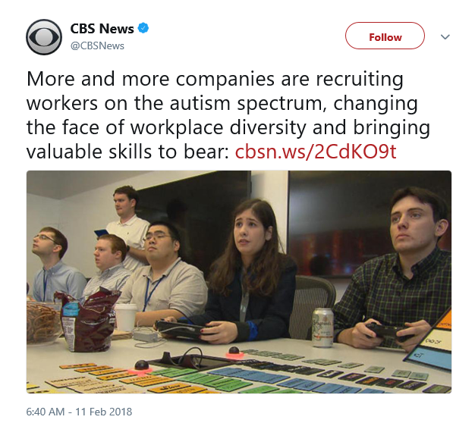
Inclusive Hiring

Slide 7

Legal & Compliance

Slide 8

Training
This Photo by Unknown Author is licensed under CC BY-SA

Slide 9

Testing
This Photo by Unknown Author is licensed under CC BY

Slide 10

Transparency
This Photo by Unknown Author is licensed under CC BY-SA

Slide 11

Accountability

Slide 12

Questions?

